Slide 1
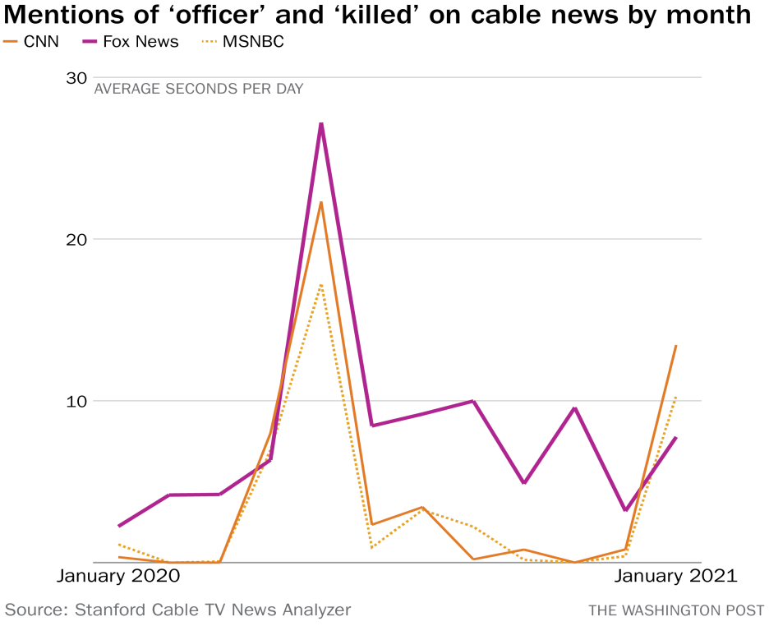
Fox News vs. CNN on Police Brutality
Student’s name
Professor’s name
Institution
Date

Slide 2
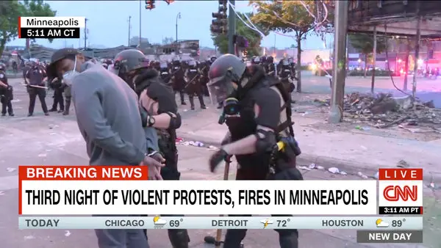
The Labelling Theory
The American society views breaking norms differently, some with deviance others with stigma.
Perception is often built on how media outlets present the order of events.

Slide 3
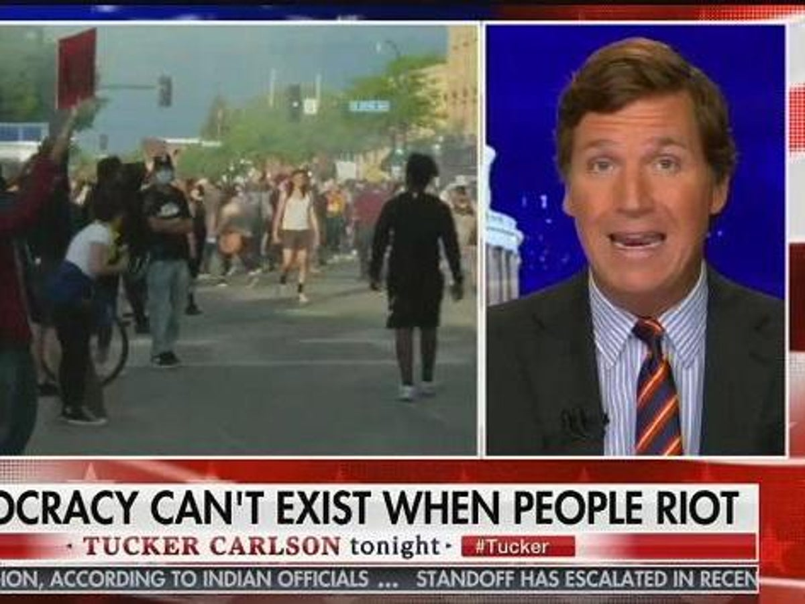
The Labeling Theory cont.
The deviant label can cause stigma towards involved individuals.
Both CNN and Fox News play a role in how over 6 million Americans view issues such as police brutality, Black Lives Matter and racism.

Slide 4
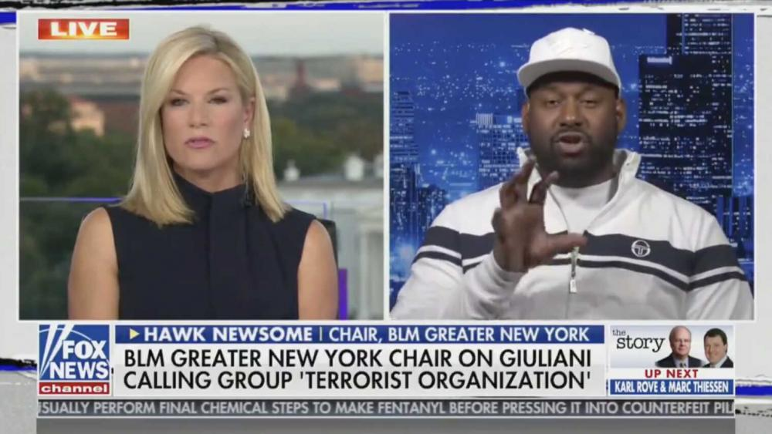
Different words
Reviewing articles published on the same occurrence, it’s easy to see Fox News Using words such as “shooting” and “ex-cop”, words that are less harsh, where as CNN used words such as “Murder” and “fired officer” (Berman, 2021).

Slide 5
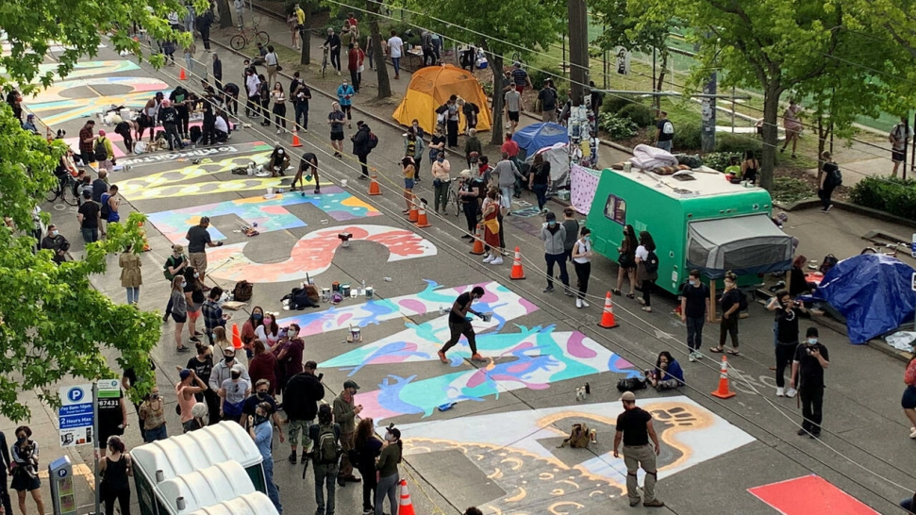
Different perceptions
Where viewers watch or read content can affect how they perceive events.
CNN tries to lean towards The Democrats while Fox News leans on the Republicans.

Slide 6
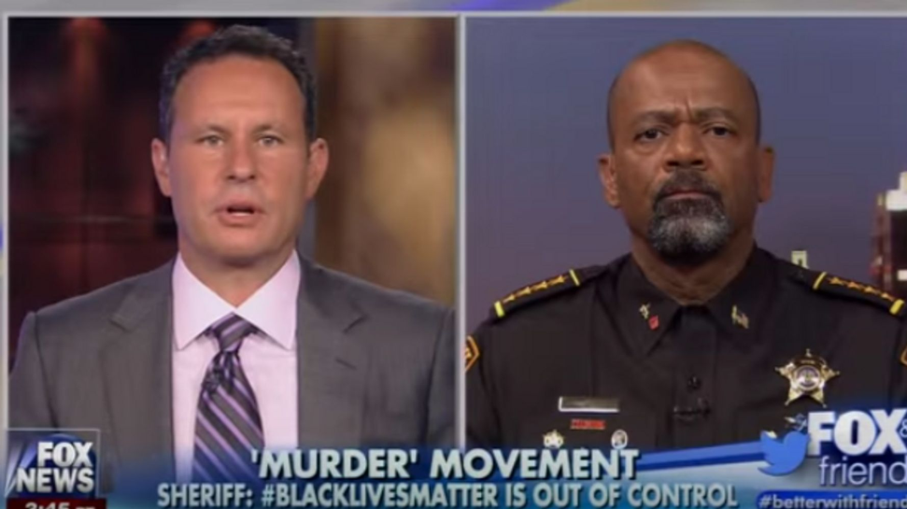
Different Headlines
Last year during the Black Lives matter protests, Fox News ran a headline “Attacks against Law Enforcement amid Nationwide Riots”.
CNN ran headlines as “Large Protests in D.C. as Curfew Pushed Back Tonight.”
MSNBC wrote “Peaceful Protests Tonight in Cities Across the U.S.

Slide 7
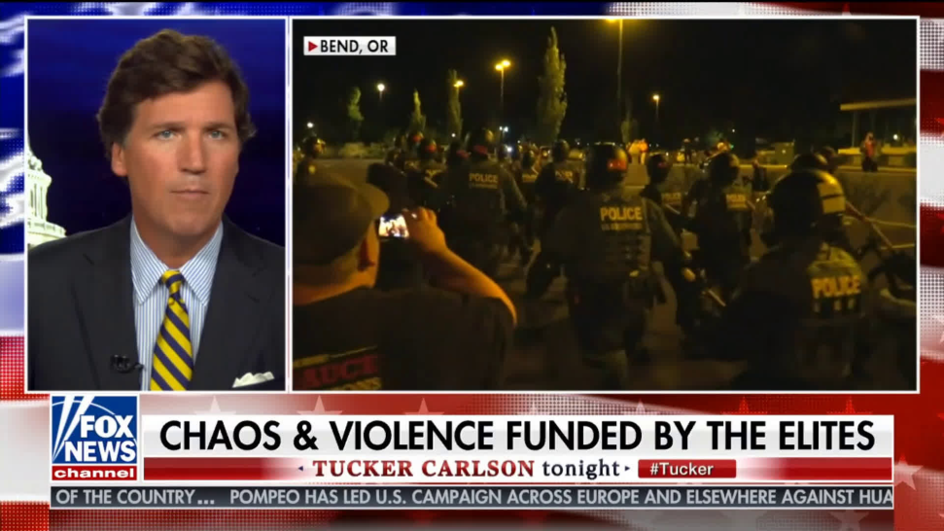
Different images
Last year during the BLM protests, Fox News avoided overhead shots and crowd perspectives.
Their correspondents reported from places that were less crowded.

Slide 8
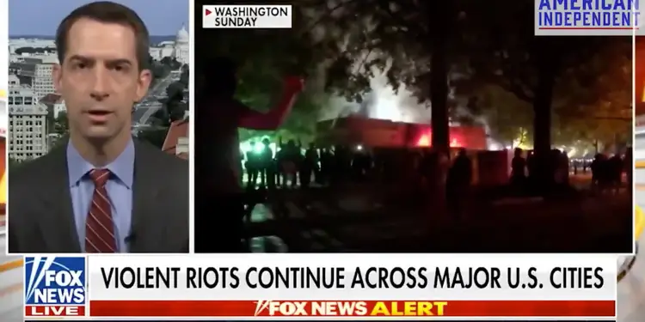
Different Images cont.
On Fox News, often, a split screen showed a non-live footage of looting.
Cameras only captured protesters over the shoulders of the police.
This prevented the audience from seeing the weapons carried by the police.

Slide 9
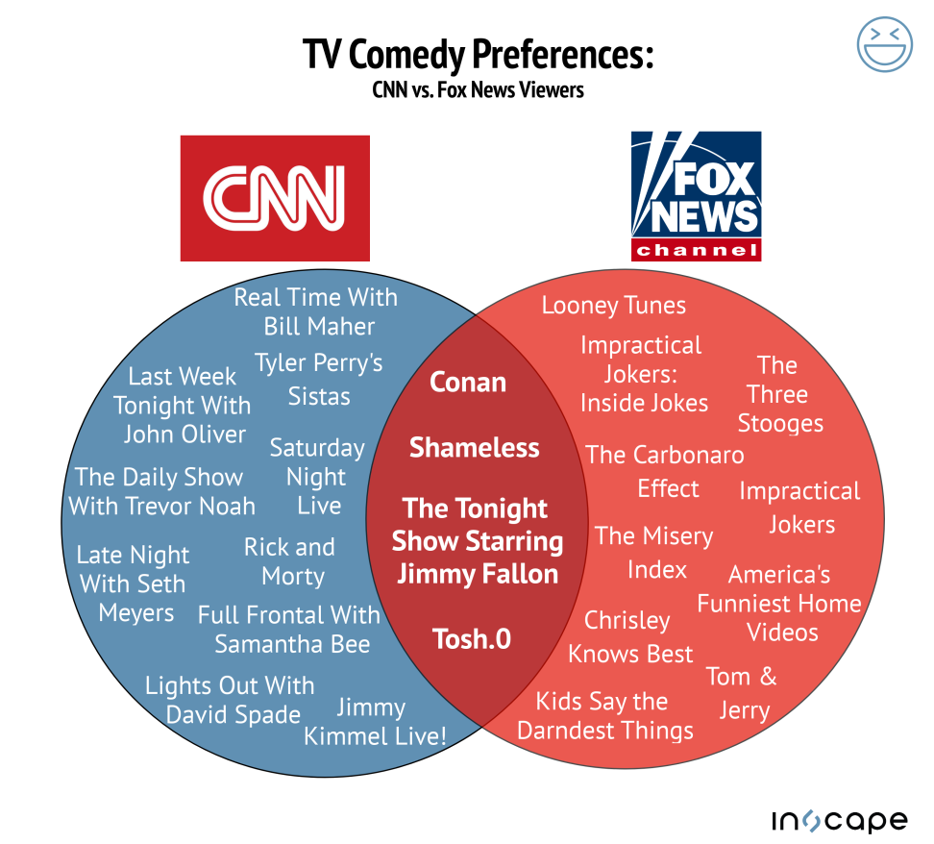
CNN and Fox News as News Channels
Both Fox News and CNN report actual news on top of the hour.
In between news, commentators and analysts discuss biased details on news stories.
The entertainers and analysts’ opinions can match either the right or the left.
Fox News tends to be more conservative and often supports the Republican Party.

Slide 10
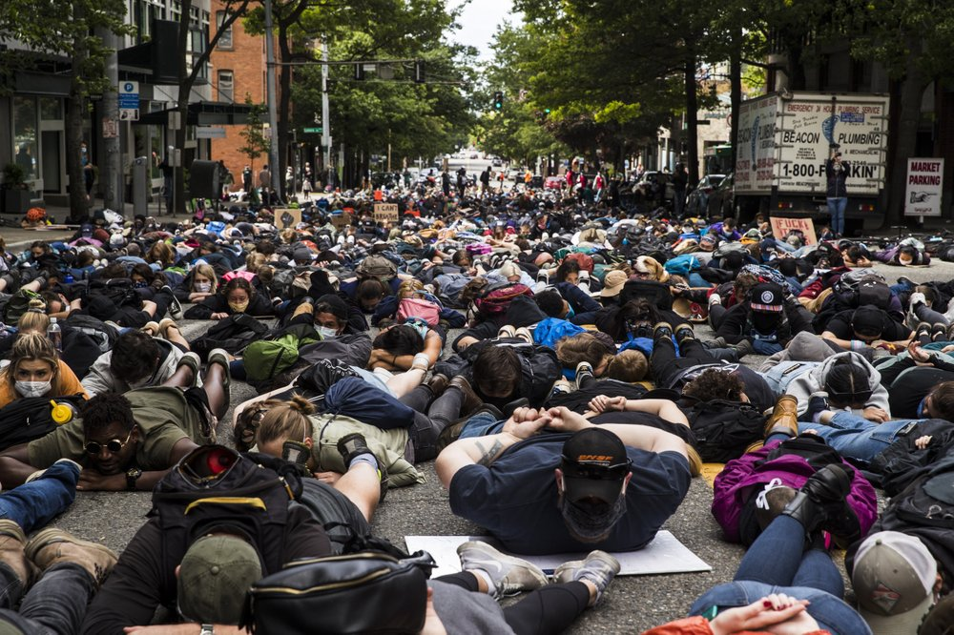
Different description of events
Both CNN and Fox News addressed the issue of Police Brutality.
CNN has published articles that critique excessive force.
In June 2021, Fox News published articles on the number of police officers shot and killed by civilians (Berman, 2021).
They cited that campaigns to defund the Police have led to these events.

Slide 11
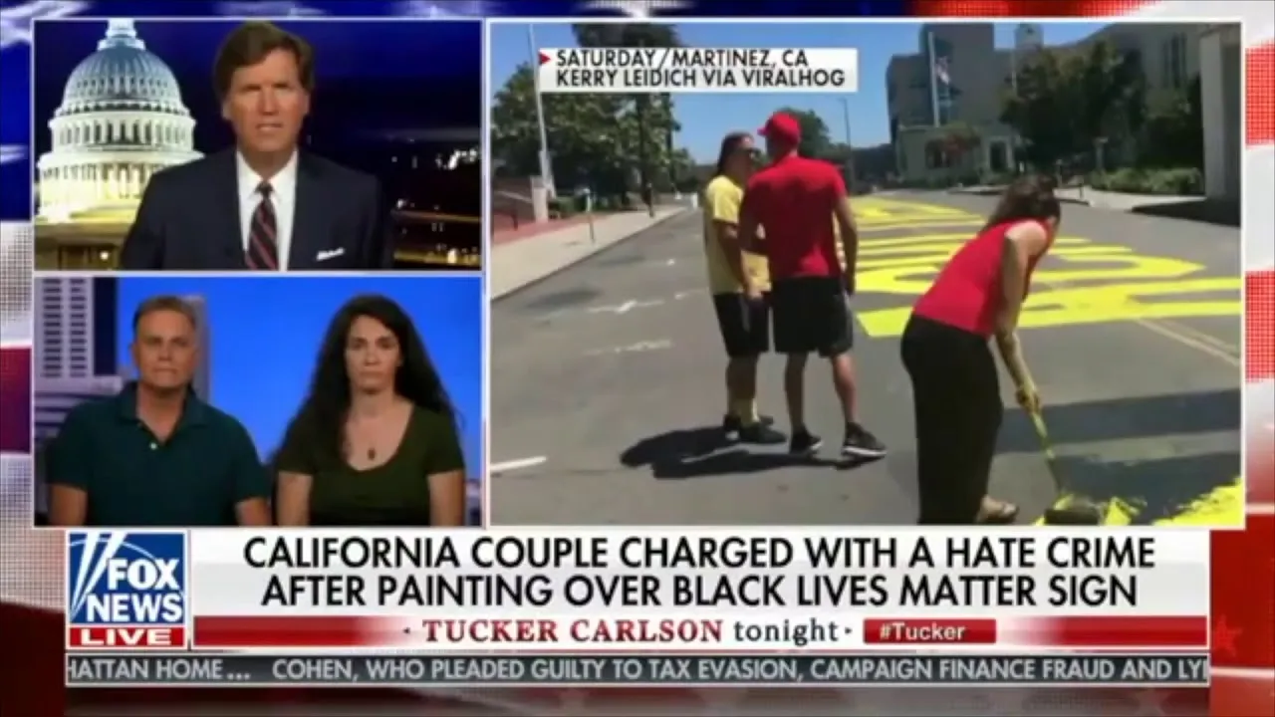
Favoritism
The titles, phrases and general statements affect how the audience perceives a situation.
It is clear from reviewing articles on law enforcement and police brutality that Fox News is more favourable to law enforcement than CNN.

Slide 12
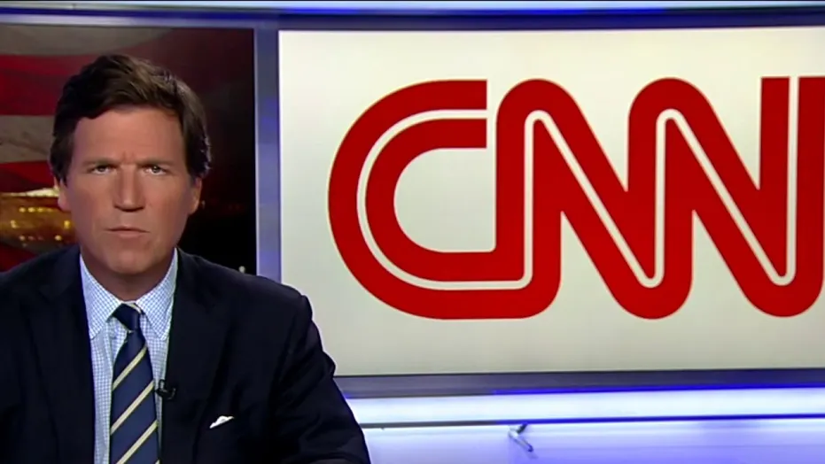
Use of language
The verbs used to describe a single incident varied, from shooting to murdering.
Homicide has the possibility of getting out of jail.
Murder carries a life sentence.
Murder has a negative connotation when compared to shooting.
CNN appears to be against use of excessive force by police officers.

Slide 13
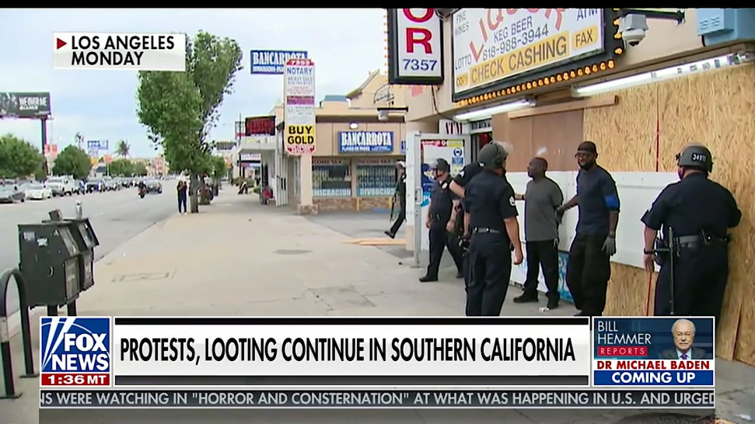
Details and their effects
Whereas Fox News gives fewer details, CNN gave more detailed description.
CNN reports the officer’s actions which point out to the officer’s mistakes.
The depth descriptions, in many times, made officers appear as inhumane and disgusting (Berman, 2021).

Slide 14
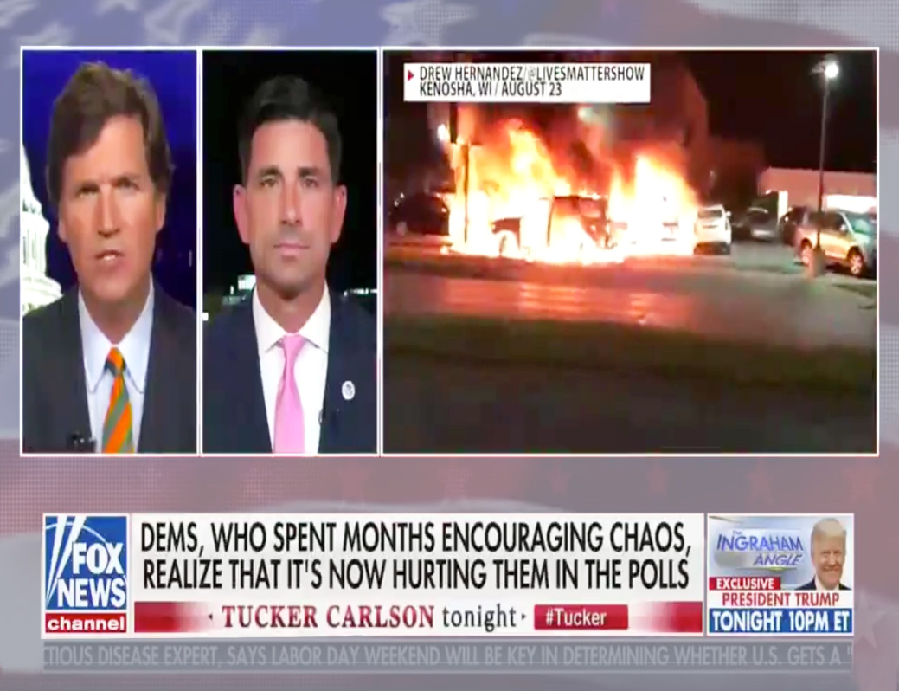
Race
Race plays a key role in most police brutality cases.
The law enforcement officer was always white, the victim an African American man.
Race was reported in the same way in both CNN and Fox News (Berman, 2021).
The gender of the officers did not matter, but men were more present than women.

Slide 15
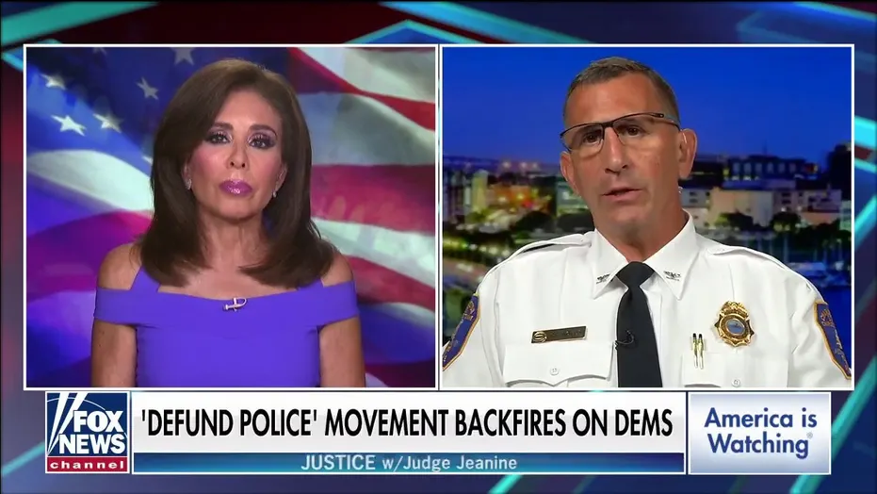
Conclusion
From comparison of articles, Fox News tried to give a view that improved the law enforcement stand.
Their articles justify the officer’s shooting and paint the officers in a positive light.
CNN focused on the officer’s actions, which often gave the officers a negative image.

Slide 16
References
Berman, J. (2021). Where You Watch George Floyd Protests Matters. Here's Why. Retrieved 19 October 2021, from https://time.com/5848555/george-floyd-protests-fox-news/
Hall, A. V., Hall, E. V., & Perry, J. L. (2016). Black and blue: Exploring racial bias and law enforcement in the killings of unarmed black male civilians. American Psychologist, 71(3), 175.

